Slide 1


SECURE DATA HIDING IN IMAGE
Presented By : Janvi
AICTE INTERNSHIP PROJECT

Slide 2
OVERVIEW
Abstract
Result
Problem Statement
End Users
Conclusion
Technology Used
Implementation
Future Scope
WOW Factor
Github Link
Thank You
AICTE INTERNSHIP PROJECT
1

Slide 3
ABSTRACT
In an era where sensitive data transmission over untrusted channels faces escalating risks, traditional encryption methods alone are increasingly vulnerable to sophisticated attacks. This project proposes a hybrid security framework that integrates Advanced Encryption Standard (AES) for robust data encryption and Least Significant Bit (LSB) steganography for covert data concealment within digital images.
2
AICTE INTERNSHIP PROJECT

Slide 4
PROBLEM STATEMENT
Steganography provides a way to hide data within images, making it undetectable.
This project addresses secure data hiding using AES encryption and LSB steganography.
AICTE INTERNSHIP PROJECT
First Problem
Second Problem
Sensitive data needs secure transmission over untrusted channels.
Traditional encryption methods are vulnerable to attacks.
3

Slide 5

TECHNOLOGY USED
Libraries :
Platforms :
OpenCV (cv2) - image processing.
Crypto - AES encryption.
Hashlib - password hashing.
numpy - numerical operations.
Python programming language.
Streamlit for building the user interface.
AICTE INTERNSHIP PROJECT
4

Slide 6
WOW FACTORS
1
Combines AES encryption with LSB steganography for enhanced security.
1
2
Password-based authentication ensures only authorized users can decode the message.
2
AICTE INTERNSHIP PROJECT
3
Real-time encoding and decoding via a user-friendly Streamlit app
4
Supports PNG images for lossless data embedding.
3
5
Secure and undetectable data hiding, making it ideal for sensitive applications.
5

Slide 7
END USERS
Individuals :
For securely sharing private information (e.g., passwords, documents).
Organizations :
For confidential communication and data protection.
AICTE INTERNSHIP PROJECT
6

Slide 8
END USERS
Government Agencies :
For secure transmission of classified information.
Researchers :
For experimenting with advanced steganography techniques.
AICTE INTERNSHIP PROJECT
7

Slide 9
IMPLEMENTATION
Features:
Implementation provides:
Military-grade AES-256-CBC encryption
Secure key derivation with PBKDF2
Automatic message length detection
Support for multiple image formats
Detailed error reporting
Visual feedback for all operations
Proper memory management
Tamper detection
Size validation
Better security through proper cryptographic practices
More reliable data embedding/extraction
Improved user experience
Better error handling
Cross-platform compatibility
Proper handling of different image types
Defense against common steganalysis techniques
AICTE INTERNSHIP PROJECT
8

Slide 10
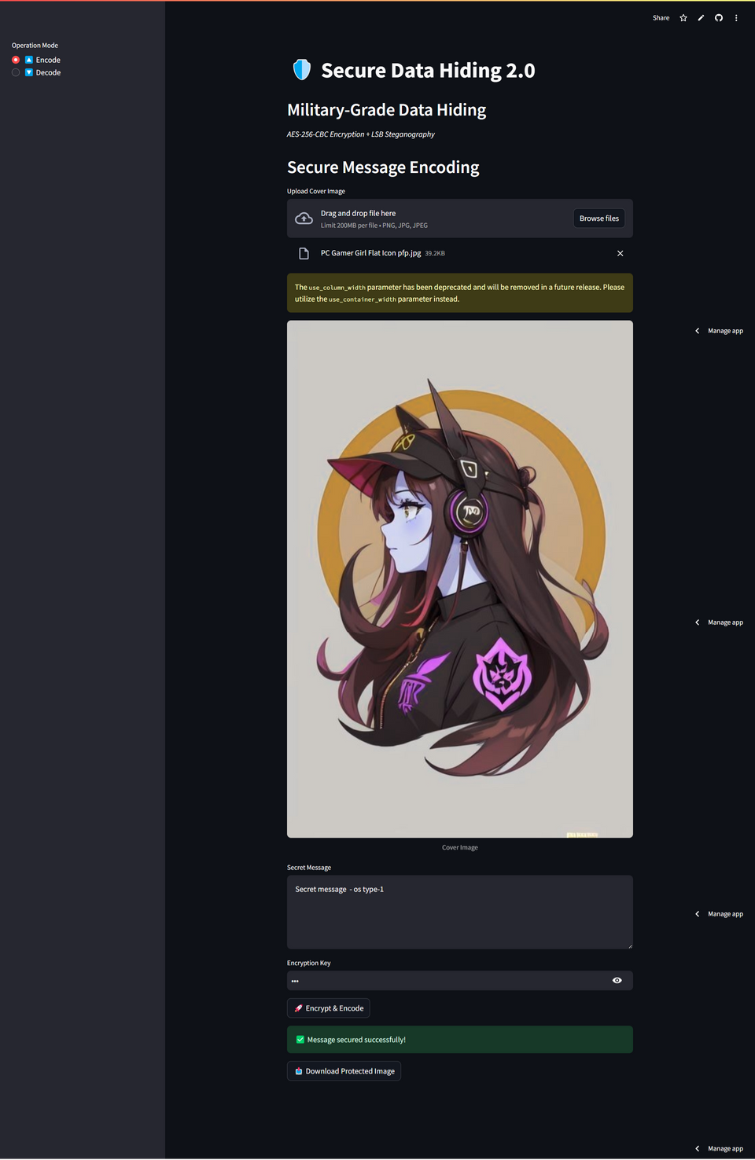
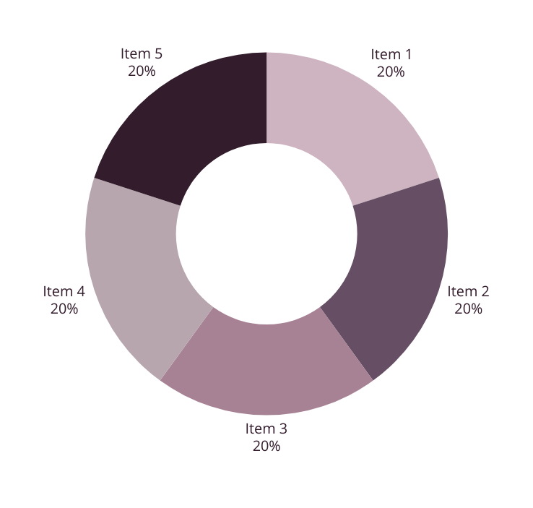
﻿RESULT
9
AICTE INTERNSHIP PROJECT

Slide 11
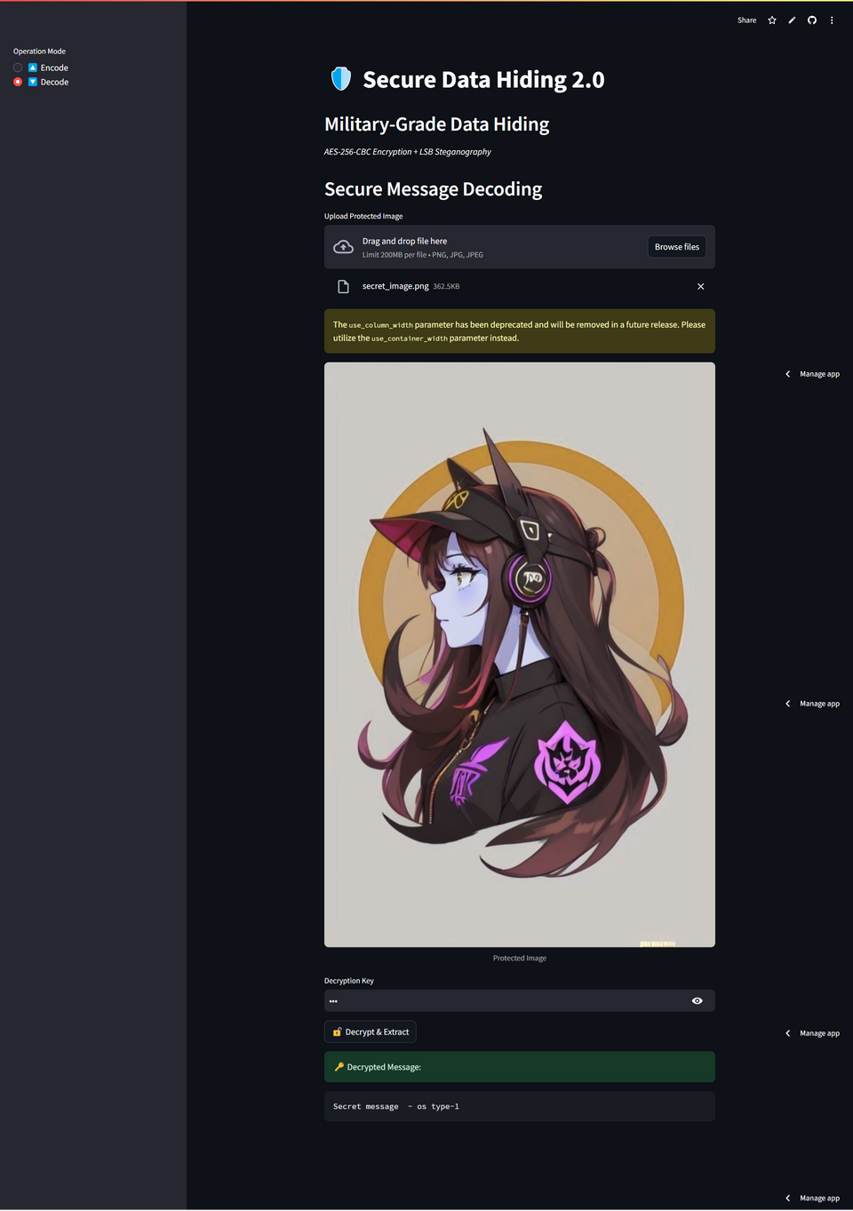

﻿RESULT
10
AICTE INTERNSHIP PROJECT

Slide 12
GITHUB LINK
REPO LINK:
https://github.com/janvi100104/AICTE-Internship-Project
README LINK:
Fauget University | 2024
https://github.com/janvi100104/AICTE-Internship-Project/blob/main/README.md
LIVE PROJECT LINK:
https://aicte-internship-project.streamlit.app/
9

Slide 13

CONCLUSION
The project successfully implements secure data hiding in images using AES encryption and LSB steganography .
It addresses the problem of secure data transmission by combining encryption and steganography.
The solution is robust, user-friendly, and suitable for real-world applications.
Future enhancements can include support for additional file formats and improved error handling.
11
AICTE INTERNSHIP PROJECT

Slide 14
FUTURE SCOPE
Extend support to other image formats like JPEG and BMP.
Implement multi-layer encryption for added security.
Develop a mobile application for on-the-go secure data hiding.
Explore AI-based steganalysis detection to test the robustness of the system.
AICTE INTERNSHIP PROJECT
12

Slide 15

AICTE INTERNSHIP PROJECT
THANK YOU
Presented By : Janvi

